Slide 1
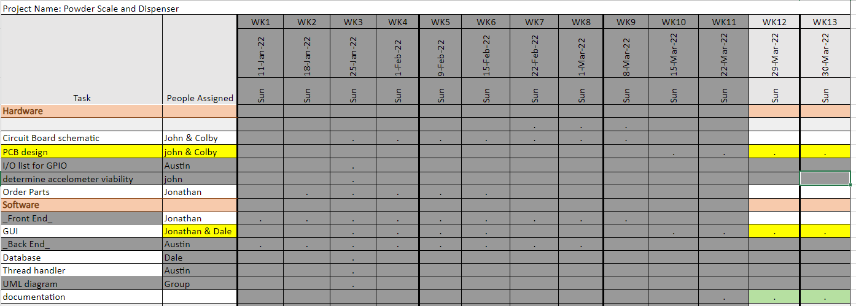
Week 11 (16-Mar to 22-Mar)

Slide 2
Week 11 (16-Mar to 22-Mar) Austin Stecklein
Goal/Task | % Done | Hours (Act.)
Installed LXDE operating display | 100% | 5
Started testing frontend | 25% | 2
Started testing backend | 40% | 6
Hours on task during the week (On track ≥ 13 / wk) | 13
Total hours on task so far this semester (On track ≥ 137 hrs) | 137

Slide 3
Progress made during the week (Log) (What I did)
Had to partition the sd card so that that GUI display libraries could be installed
Python likes to run on visual studio differently on visual studio code to running on Beaglebone black
Got required hardware to test backend(i.e. correct cables and stepper driver) then started to tested functions

Slide 4
Goals for this coming week (Ones that move the project forward the most)
Goal/Task | Stop Date (Est.) | Hours (Est.)
Get Dale and John to get frontend to run on the beaglebone | 4/4 | 1
Tie frontend and backend together to test together | 4/4 | 10
Get haptic motor and speaker connected to board and running with everything else. | 4/4 | 2
Estimated time needed to work on goals for this coming week (typ. 13 hrs) | 13

Slide 5
Week 11 (16-Mar to 22-Mar) Jonathan Phillips
Goal/Task | % Done | Hours (Act.)
Front end – Updated GUI and Keyboard Changes | 87 | 8
Front end – Merged Code | 100 | 5
Front end - Documentation | 35 | 1
Front end - Testing | N/A | 2
Hours on task during the week (On track ≥ 13 / wk) | 15
Total hours on task so far this semester (On track ≥ 137 hrs) | 127

Slide 6
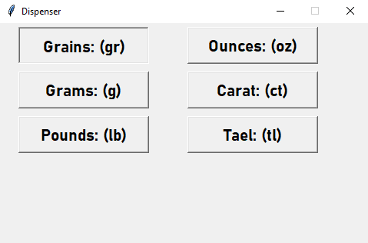
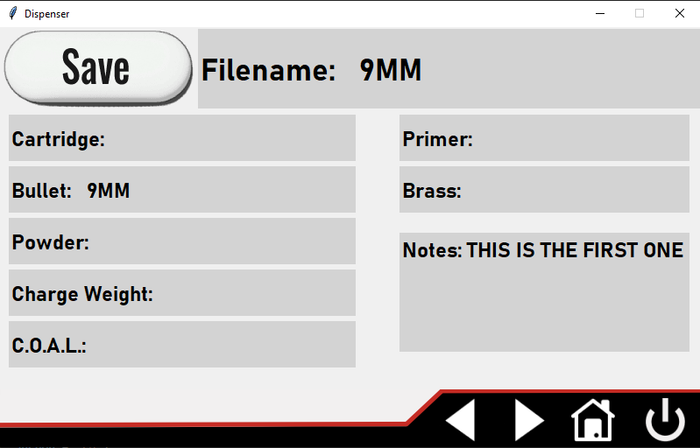
Progress made during the week (Log) (What I did)

Slide 7
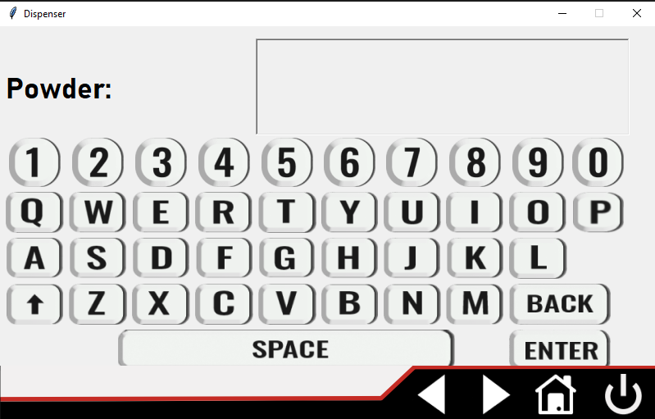
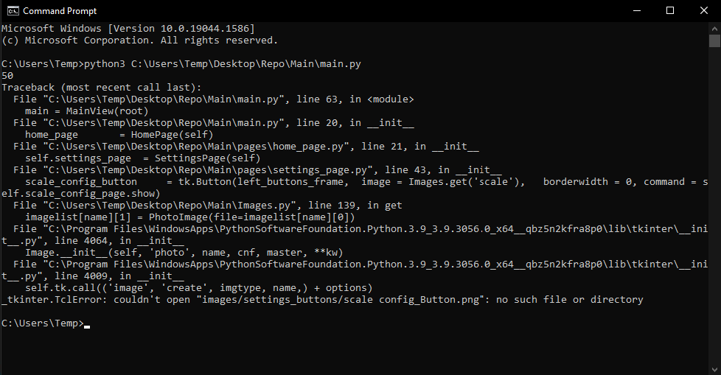
Difficulties encountered during the week (What I did not do and why)
Changed how the Keyboard is defined
Page from module
Code runs on both of my machines, but others have issues
Images are the issue

Slide 8
Goals for this coming week (Ones that move the project forward the most)
Goal/Task | Stop Date (Est.) | Hours (Est.)
Front end – Ensuring Code Runs on Every Machine | 3/30/22 | 4
Front end – General Progression | 4/4/22 | 5
Front end - Documentation | 4/4/22 | 2
Front end - Testing | 4/4/22 | 2
Estimated time needed to work on goals for this coming week (typ. 13 hrs) | 13

Slide 9
Week 11 (16-Mar to 22-Mar) - Dale Andreoli
Goal/Task | % Done | Hours (Act.)
Settings pages – connect to/create backend: Sound/brightness page |  | 8
Merge more of my features with Jonathan’s |  | 4
(if backend is done and working) Begin Documentation: Comments |  | 6
Hours on task during the week | 13
Total hours on task so far this semester | 135

Slide 10
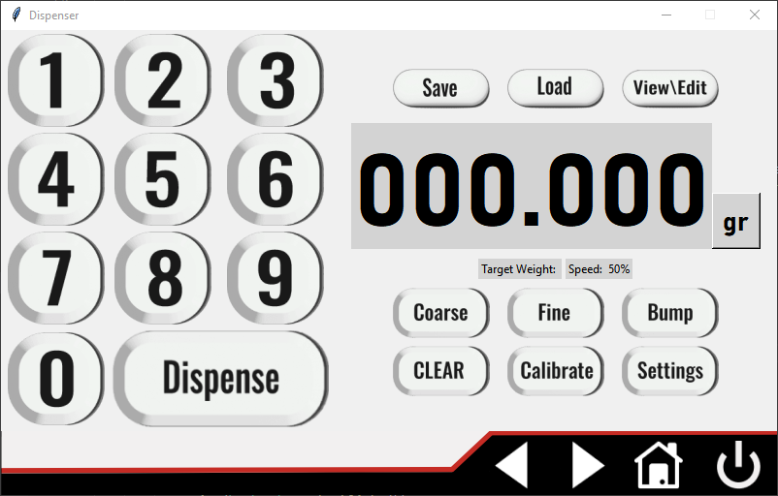
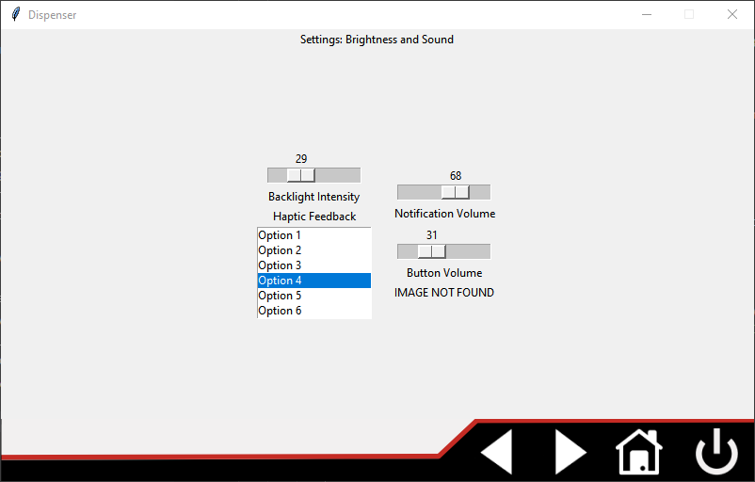
Progress made during the week (Log) (What I did)
Created and connected backend for brightness and sound settings
Merged the last of my features with Jonathan’s work

Slide 11
Difficulties encountered during the week (What I did not do and why)
Problems from the merge:
Numpad functionality
Some images not loading

Slide 12
Goals for this coming week (Ones that move the project forward the most)
Goal/Task | Stop Date (Est.) | Hours (Est.)
Finalize layout/fonts/images | 3/30 | 6
Work with Jonathan to repair numpad | 3/24 | 2
Work with Austin to finalize the backend | 3/30 | 7
Estimated time needed to work on goals for this coming week | 13

Slide 13
Week 11 (16-Mar to 22-Mar) Colby Hatton
Goal/Task | % Done | Hours (Act.)
Spec out list for JLCPCB | 75%* | 8
Order PCB | :( | 1
Begin Documentation | 15% | 4
Cry | ~60% | .75
Hours on task during the week (On track ≥ 13 / wk) | 13
Total hours on task so far this semester (On track ≥ 137 hrs) | ~140

Slide 14
Progress made during the week (Log) (What I did)
Started the complete BOM, found components, attempted to spec out the board on JLCPCB
Began documentation, prepared files for a possible future group

Slide 15
Difficulties encountered during the week (What I did not do and why)
Unfortunate discovery regarding multiple parts
Everything in the world is out of stock

Slide 16
Goals for this coming week (Ones that move the project forward the most)
Goal/Task | Stop Date (Est.) | Hours (Est.)
Documentation | 4/4 | 9
Alternate components | 4/4 | 4
Estimated time needed to work on goals for this coming week (typ. 13 hrs)

Slide 17
How can we help you achieve your goals?
Survive to the end of the semester

Slide 18
Week 11 (16-Mar to 22-Mar) John Stinger
Goal/Task | % Done | Hours (Act.)
Start Documentation |  | 6
Define the Components for JLPCB |  | 4
Documenting and Discussing Issues |  | 2
Hours on task during the week (On track ≥ 13 / wk) | 12
Total hours on task so far this semester (On track ≥ 124 hrs) | 115

Slide 19
Progress made during the week (Log) (What I did)
For example: Resources found (links, manuals), Designs created, Decisions made and corresponding rational, Photos of prototype progress, etc.
The board is done-ish
Documentation is started
Started Outlining Issues

Slide 20
Difficulties encountered during the week (What I did not do and why)
Issues with the JLCPCB stocks

Slide 21
Goals for this coming week (Ones that move the project forward the most)
Goal/Task | Stop Date (Est.) | Hours (Est.)
Finish documentation |  | 6
Completely outline hang-ups |  | 6
Estimated time needed to work on goals for this coming week (typ. 13 hrs) | 12

